Slide 1

Add/Sub
By:
Inderpal Singh Sukhpinder Singh Pierreline Jacob Feranmi Falodun
05/06/2025

Slide 2
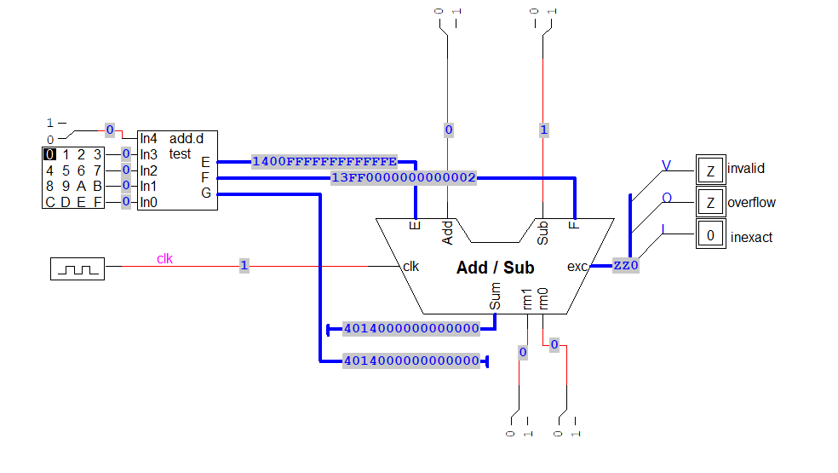
Top-Level Add/Sub Testing Circuit Overview
🔹 This is the outer block of the floating-point Add/Sub circuit.
🔹 It receives:
- Input E: 1400FFFFFFFFFFFE = 3.999…91
- Input F: 13FF000000000002 = 1.000…04
- Output Sum: 40140…0 = 5.0
- Control: Add , Sub are active low signals
🔹 These values are passed into the internal datapath block for processing.
Notes:
SUKH: Slide 1: Two 32-bit inputs (A and B) are fed into the unit from registers, and a control signal (likely Add/Sub) determines whether addition or subtraction is performed. The blue lines show active signal paths, and the result is output as Z, with exception flags like Invalid, Overflow, and Inexact set depending on the result. A clock (clk) signal synchronizes the operation, ensuring it's edge-triggered. The constants seen on the data bus (0x400...) are IEEE 754 floating-point representations, hunting this unit may support floating-point arithmetic. The left-side block is a memory or instruction decoder controlling inputs and the type of operation.

Slide 3
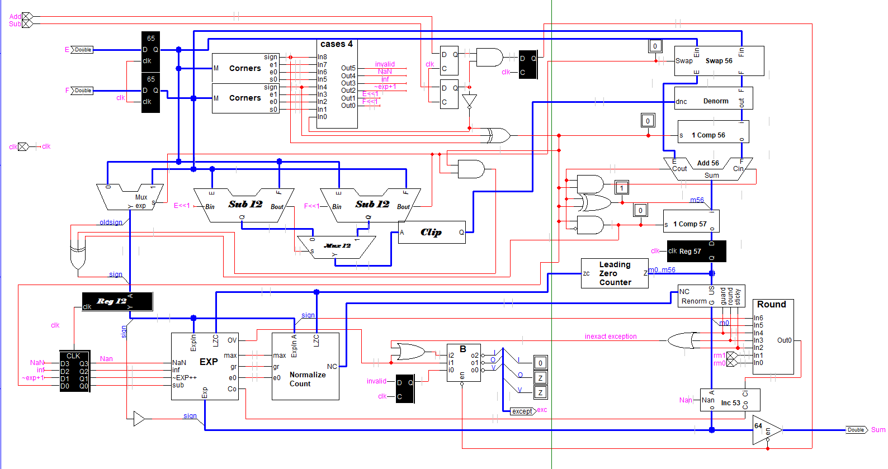
Second Pipeline Stage
Add or Subtract is possible every clock cycle because of pipelining
Notes:
line

Slide 4
Module: Tester
Function:
192-bit EPROM
Tester with 32 test cases controlled by the keyboard
Tests how double-precision floating point numbers behaves in edge cases
EX: Very small/large numbers, Rounding errors, Overflow and Underflow, Infinity and Not a Number(nan), and Precision boundaries
Notes:
This is feranmi

Slide 5
Register & Decode Inputs
Hidden one
Modules: Reg, Corners
Function:
Inputs E and F (1400FFFFFFFFFFFE, 13FF000000000002) are loaded
Extract sign, exponent= all 0 or 1, and significand =0
Cases PLA checks for special values (NaN, INF, GU, etc.)
exponent
Notes:
Line

Slide 6
Exponent Comparison & Swap
Modules: Sub 12, Swap, Clip
Function:
Two exponent differences are calculated (E-F=1; F-E=FFF)
If needed, swap operands so the one with the larger exponent is E
Positive exponent is clipped before sending to the denormalizer
In this case: E stays; no swap needed
Output: F is passed to the denormalizer
Notes:
Line

Slide 7
Mantissa Alignment (Denormalization)
Modules: Positive Difference, Clip, Denorm
Function:
Mantissa of the smaller exponent is right-shifted by the positive difference, limited by 63
Clip ensures that the number remains between 0-63 bits
Denorm generates extra bits for rounding and these extra bits are used for inexact
Output: Aligned mantissas, ready to be subtracted
For net subtraction: 1's complement of F is added
Notes:
feranmi

Slide 8
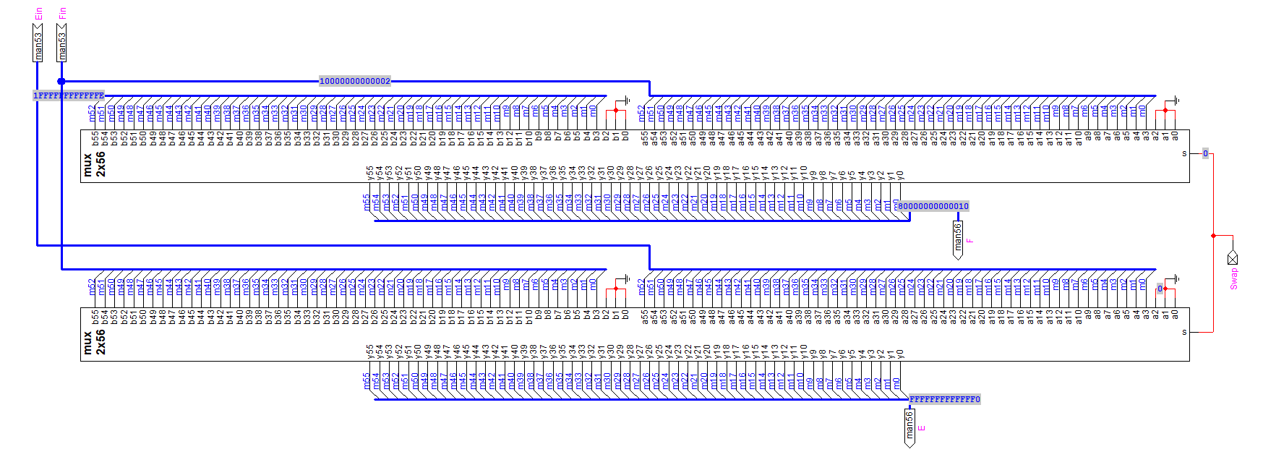
Swap
Swapping because we need smaller number for the denormalizer
Increasing the number of bits to 56
Notes:
Sukhpinder Singh

Slide 9
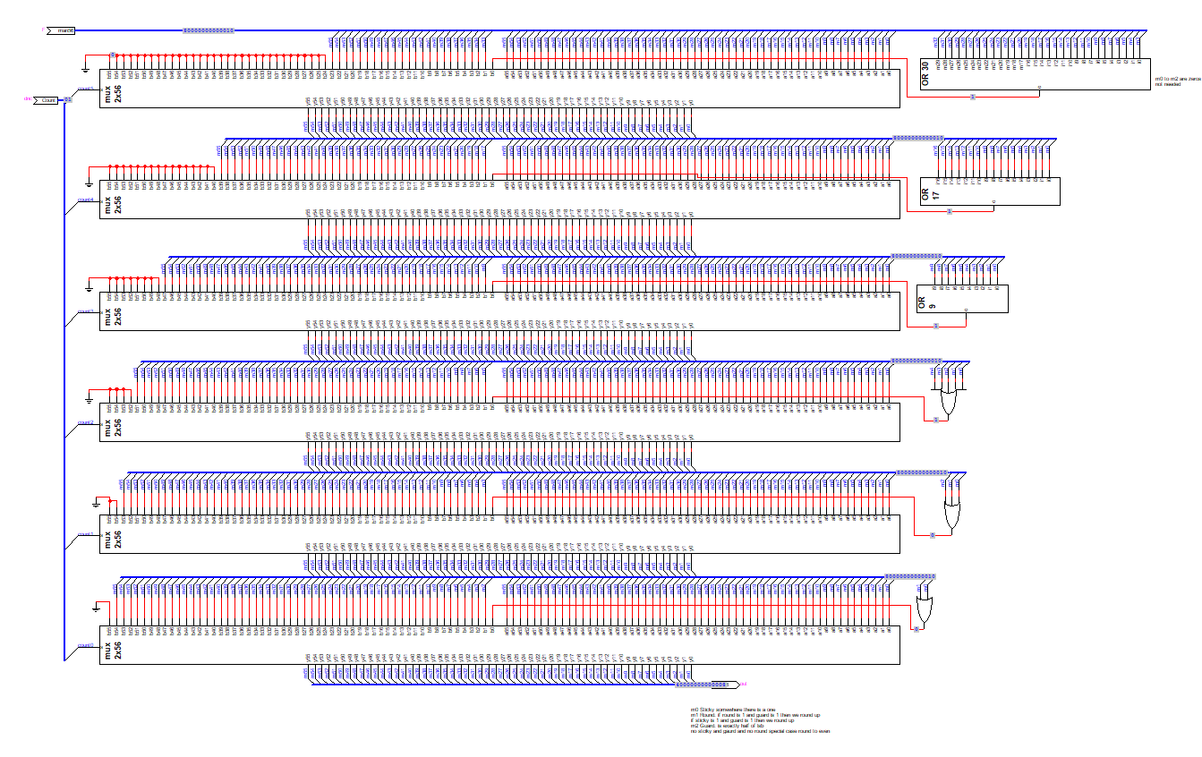
Denormalizer
Right Barrel shifter 0-63 bits
OR gates are summarizing the information otherwise discarded for use in rounding and inexact
Notes:
Sukhpinder Singh

Slide 10
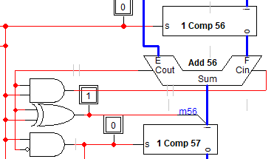
Mantissa Addition or Subtraction
Modules: Add 56, 1 Comp 57
Function:
ALU performs 1’s complement addition or subtraction of mantissas
Handles edge cases (overflow, small values, negative result)
Output: Unnormalized result of addition or subtraction
Notes:
Inderpal
For net subtraction it going complement 1 comp 56 and than gogin add the 56 because subtraction you carry out get wrapped back into Cin and if F mantissa is bigger than E mantissa than we end up with negative result we need complement again
Carryout becomes the 57 bit during addition
For net subtraction, the F mantissa goes through the 1’s complement block (1 Comp 56). Then it's added to the E mantissa using the Add 56 module. Since we're doing subtraction, we also set Cin = 1 to complete the 2’s complement subtraction (E + ~F + 1).
If F is greater than E, the result becomes negative — so we need to complement the result again using 1 Comp 57.
The carry-out from the addition becomes the 57th bit, which helps determine if the final result is negative and needs correction.

Slide 11
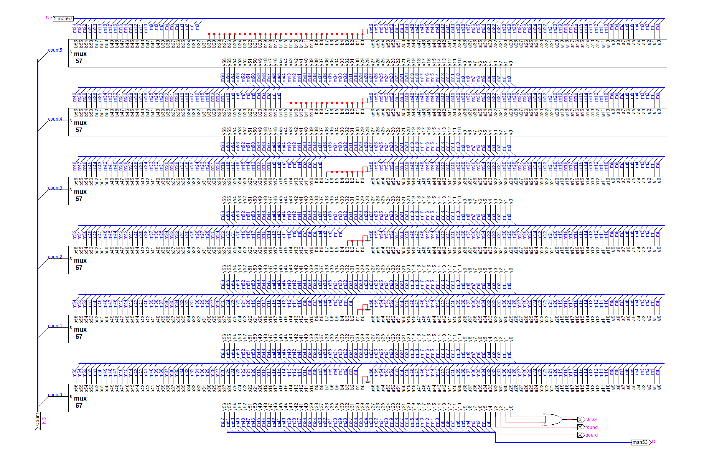
Renormalization
0-63 bit left shift
Extra bits becomes sticky, round, and guard
Notes:
Inderpal

Slide 12
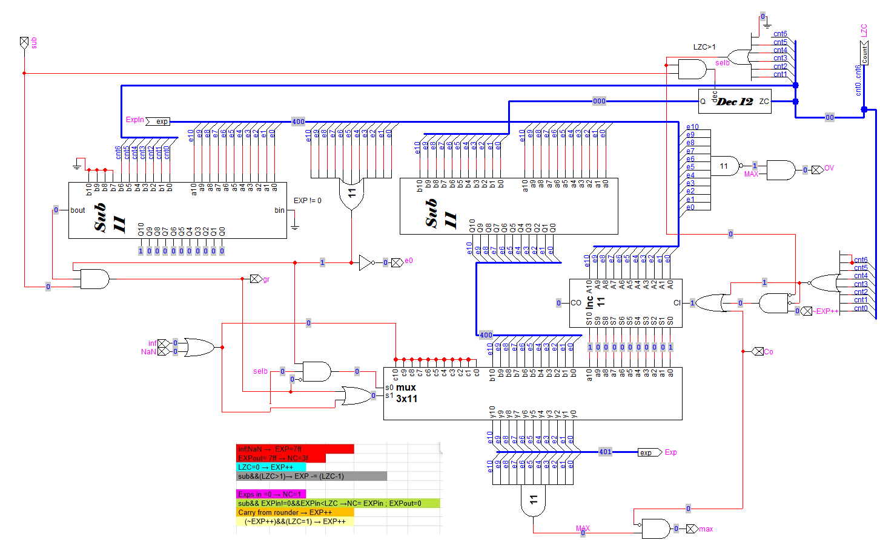
Exponent Adjustments
Notes:
Line

Slide 13
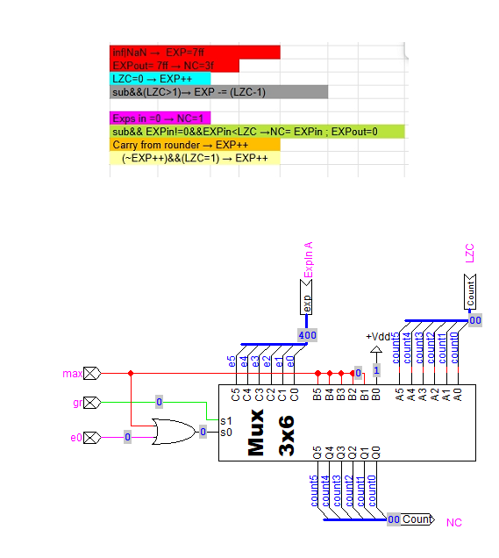
Normalization Count
Notes:
Feranmi

Slide 14
Normalization
Modules: Leading Zero Counter, Normalize Count, EXP
Function:
Counts leading zeros in result
Shifts result left and decreases exponent
Default assumes that addition will generate a larger leading bit, so the default binary point is moved left.
In Test Case 0: No shift needed; result is already normalized
Notes:
Feranmi Because We made a Major revision to what was done in previous classes, the order of rounding and normalization was reversed, greatly simplifying the circuit.

Slide 15
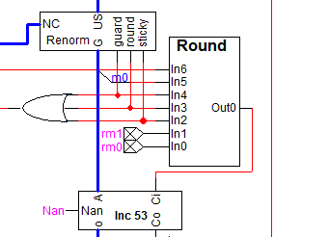
Rounding
Modules: Round, rm0, rm1
Function:
Modes:
0 : RN Round result to nearest representable value
1 : RZ Round toward zero
2 : RP Round toward +∞
3 : RM Round toward -∞
Applies rounding based on modes
Adjusts LSB and exponent if needed
Output: Final IEEE-754 result
Notes:
Inderpal
If the Guard bit is 1, m0 is 1, and the rounding mode is 0 (Round to Nearest), then the result is rounded to the nearest even value.
If a carry-out occurs during rounding, the exponent must be incremented to keep the result normalized.

Slide 16
Exception Detection & Output
Exception flags
Invalid : Discover in cases
Overflow : Discover in exponent adjustments
Inexact : Discover in rounding and includes overflow
Outputs the final 64-bit result to Sum
Test Case 0 Output:
Result = 4014000000000000
Flags = active low signals (0, Z, Z)
Notes:
Line maybe

